Slide 1
HUMAN ACTIVITY RECOGNITION
Real-Time Activity Detection using Pose Estimation & Machine Learning
Internship Project Presentation
Group project | AIML Diploma, MSBTE | Class AN-A

Slide 2
Agenda
01
02
03
Introduction
Objective
Tech Stack
What is Human Activity Recognition
Goals of this project
Tools and libraries used
04
05
06
System Workflow
Data Collection
Model Training
How the pipeline works end-to-end
Capturing pose landmarks via webcam
Random Forest classifier
07
08
09
Live Demo & Results
Challenges & Learnings
Conclusion & Future Scope
Real-time predictions and accuracy
Issues faced and how they were solved
Wrap up and next steps
Human Activity Recognition
2

Slide 3
Introduction
Human Activity Recognition (HAR) is the process of identifying what a person is physically doing — such as standing, sitting, walking, or waving — using visual or sensor data, and is widely used in fitness tracking, surveillance, healthcare monitoring, and human-computer interaction.
Approach Chosen
Video / Webcam-based
(instead of wearable sensor data)
1
No extra hardware needed — just a webcam
This project builds a webcam-based HAR system: it captures body pose in real time and classifies the ongoing activity using a trained machine learning model.
Uses body pose landmarks, not raw pixels
2
3
Real-time skeleton tracking with MediaPipe
Human Activity Recognition
3

Slide 4
Objective
1
2
3
4
Capture
Extract
Classify
Predict Live
Record human body pose in real time using a webcam feed
Convert each pose into 33 landmark points (x, y, z) — 99 numeric features
Train a machine learning model to recognize the activity from those features
Display the predicted activity on screen instantly, frame by frame
End Goal:
A working real-time system that recognizes 4 activities — standing, sitting, walking, waving — directly from a live webcam feed.
Human Activity Recognition
4

Slide 5
Technology Stack
Py
Python 3.11
Cv
OpenCV
Mp
MediaPipe 0.10.14
Core language (3.11 venv used for MediaPipe compatibility)
Webcam capture, frame processing & on-screen display
Real-time pose detection — 33 body landmarks
Sk
scikit-learn
Pd
pandas
Jl
joblib
Random Forest classifier for activity prediction
Loading & merging landmark datasets (CSV)
Saving & loading the trained model (.pkl)
Human Activity Recognition
5

Slide 6
System Workflow
1
2
3
4
5
6
Webcam Input
Pose Detection
Feature Extraction
ML Prediction
Majority Voting
Dashboard Output
▶
▶
▶
▶
▶
Live video frame captured via OpenCV
MediaPipe detects 33 body landmarks per frame
(x, y, z) of each landmark → 99 features
Random Forest predicts activity + confidence %
Last 10 predictions smoothed for a stable label
Skeleton + activity, confidence, bar shown live
Pipeline: Camera → Pose Landmarks → Feature Vector → Trained Model → Live Prediction
Human Activity Recognition
6

Slide 7
Data Collection
collect_data.py
A dedicated script records pose landmarks for one activity at a time and appends them to that activity's CSV file.
Each Frame Becomes
33
1
User enters activity name (standing / sitting / walking / waving)
body landmarks
detected by MediaPipe Pose
2
Webcam opens — MediaPipe Pose tracks the body in real time
3
For every detected frame, all 33 landmarks' (x, y, z) are extracted
99
4
Each row of 99 values is written to dataset/<activity>.csv
numeric features per frame
(x, y, z for each landmark)
Stored as one row per frame in the activity's CSV file
Human Activity Recognition
7

Slide 8
Dataset Overview
2630
2373
7,759
1606
Total samples
across all classes
1150
4
Activity classes:
Standing, Sitting,
Walking, Waving
Standing
Walking
Waving
Sitting
samples (rows) collected per activity class
Human Activity Recognition
8

Slide 9
Model Training
train_model.py
Why Random Forest?
Algorithm
Random Forest Classifier
✓
Handles numeric landmark data well, no scaling needed
Estimators
100 decision trees (n_estimators = 100)
✓
Robust to noise from small pose-tracking jitters
Data Split
80% training / 20% testing (stratified)
Input
All 4 CSVs merged — labeled by activity name
✓
Fast to train — avoided deep learning setup issues
Output
Saved model → models/activity_model.pkl (via joblib)
Gave excellent accuracy on this dataset size
✓
Human Activity Recognition
9

Slide 10
Code Architecture
The project was refactored from one script into clean, modular components:
camera.py
predictor.py
ui.py
Camera class — opens/reads/releases the webcam feed
ActivityPredictor class — loads the model, returns activity + confidence
draw_ui() — renders the AI Dashboard panel (activity, confidence bar)
predictor.py — confidence score
app.py — majority-vote smoothing
if hasattr(self.model, "predict_proba"):
confidence =
max(self.model.predict_proba(
[landmarks])[0]) *
100
prediction_history = deque(maxlen=10)
prediction_history.append(activity)
stable =
Counter(prediction_history)\
.most_common(
1)[0][0]
Result: smoother, more reliable predictions — no flickering between activities frame to frame.
Human Activity Recognition
10

Slide 11
Results
What this means
99.68%
1
The 4 activities — standing, sitting, walking, waving — are visually distinct in pose, so landmark features separate them cleanly
2
Random Forest generalized well despite a modest dataset size
Model Accuracy on Test Set
(20% held-out stratified test split)
3
Predictions remain stable and consistent frame-to-frame in live testing
Human Activity Recognition
11

Slide 12
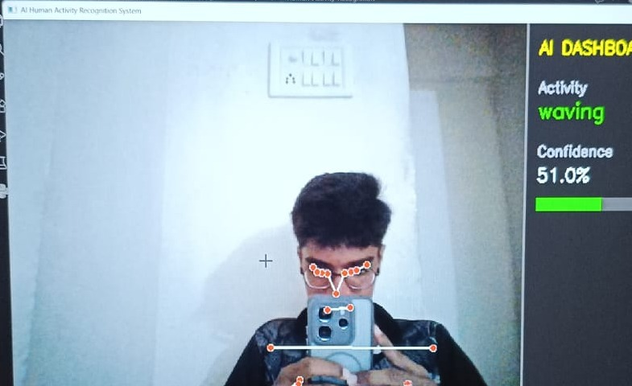
Real-Time Prediction (app.py)
How it runs live
1
Loads the trained model via ActivityPredictor
2
Captures live frames and runs MediaPipe Pose
3
Draws the skeleton overlay on the video feed
4
Predicts activity + confidence, smooths over last 10 frames
5
Renders the AI Dashboard panel live until ‘Q’ quits
Actual output — live webcam test
Human Activity Recognition
12

Slide 13
Challenges & Learnings
Version conflicts
TensorFlow, protobuf, and MediaPipe clashed on Python 3.13
→ Set up a dedicated Python 3.11 virtual environment on Windows
MediaPipe API changes
Newer MediaPipe versions removed the mp.solutions API used for pose
→ Pinned to MediaPipe 0.10.14, which still supports it
Model choice
Originally planned an LSTM (deep learning) approach
→ Switched to scikit-learn's Random Forest — simpler, faster, and just as accurate for this data
Human Activity Recognition
13

Slide 14
Conclusion & Future Scope
Conclusion
Future Scope
Built a complete real-time HAR pipeline — from webcam pose capture to live activity prediction — achieving 99.68% accuracy on 4 activity classes using MediaPipe and a Random Forest classifier.
1
Add more activity classes (running, jumping, falling)
2
Explore LSTM / deep learning for sequential motion patterns
Solved real environment/version issues independently, showing practical debugging and adaptability alongside the ML work.
3
Deploy as a web app or mobile app for wider use
4
Add multi-person detection in a single frame
Human Activity Recognition
14

Slide 15
Thank You
Questions & Discussion

